Slide 1

BloodBank AI: Solving the Global Blood Crisis
An invisible neurosymbolic AI system that orchestrates blood supply chains in real-time—saving lives without requiring anyone to change their behavior.

Slide 2
The Crisis Killing 10,000 Daily
10K
15%
35
5km
Daily Deaths
Blood Wasted
Days to Expire
Average Distance
People die every day from lack of available blood—a completely preventable tragedy
Discarded due to expiration while nearby hospitals face critical shortages
Blood units have limited shelf life, creating urgent logistics challenges
Between hospitals with surpluses and those with critical shortages
The blood supply chain is fundamentally broken. Hospitals desperately need blood while units expire unused just kilometers away. No real-time coordination exists.

Slide 3

Why the Current System Fails
No Real-Time Visibility
Manual Coordination
Inefficient Distribution
Blood banks and hospitals don't share inventory data. Each operates blind to what others have or need.
Emergency needs trigger frantic phone calls and WhatsApp messages. Critical time is lost searching for blood.
Hospital A throws away expiring O+ while Hospital B cancels surgeries for lack of O+—despite being 5km apart.

Slide 4



BloodBank AI: Invisible Orchestration
The breakthrough insight: Nobody needs to change their behavior. The AI works entirely behind the scenes.
Real-Time Network
Neural network connects all hospitals, blood banks, ambulances, and ERs via simple API integration. Tracks inventory, expiry dates, and demand patterns continuously.
Intelligent Routing
Knowledge graph maps relationships between 50+ hospitals, 200+ donation centers, blood units, donors, and patients. GNN reasoning instantly finds optimal solutions.
Automatic Coordination
System dispatches couriers, reserves blood, notifies staff, and calls donors—all automatically using existing infrastructure and workflows.

Slide 5

Emergency Response: 3:47 AM Car Accident
What the Paramedic Does
What the AI Does (Invisibly)
Receives data: 3 patients incoming with blood type needs
Scans patient wristband or enters basic information on their standard tablet—exactly what they already do today.
Checks knowledge graph: Receiving hospital lacks sufficient O-negative units
GNN solves in 2 seconds: Finds compatible blood 7km away, prioritizes units expiring soonest
What the Doctor Sees
Simple notification: "O- blood ready in trauma bay"
Coordinates automatically: Reserves blood, dispatches courier, notifies ER team
They think: "Wow, we're prepared today."
Blood arrives 2 minutes before ambulance

Slide 6
Three Scenarios, Zero Behavior Change
1
2
3
Emergency Optimization
Wastage Prevention
Smart Donor Outreach
Multi-vehicle accident with 3 critical patients. AI coordinates blood from 5 locations, prioritizing expiring units, ensuring everything arrives before patients. ER team simply receives notification.
System detects 20 units of A+ expiring in 48 hours at Center North, predicts no local demand, finds Hospital South needs A+ tomorrow. Automatically arranges transfer using existing couriers.
AI predicts AB- shortage in 72 hours, analyzes 10,000 donors, identifies 50 eligible AB- donors based on location, donation history, and past responsiveness. Sends personalized SMS requests.

Slide 7


Why Adoption Happens Instantly
For Hospitals
For Blood Banks
80% reduction in blood shortages
Less waste equals more funding
60% reduction in wastage
Better utilization metrics
No staff training required
Simple API integration
Works with existing systems
Enhanced coordination capability
Saves $200-500 per unit
For Government
National blood crisis solved
No public behavior change needed
Massive healthcare cost savings
Immediate political win

Slide 8
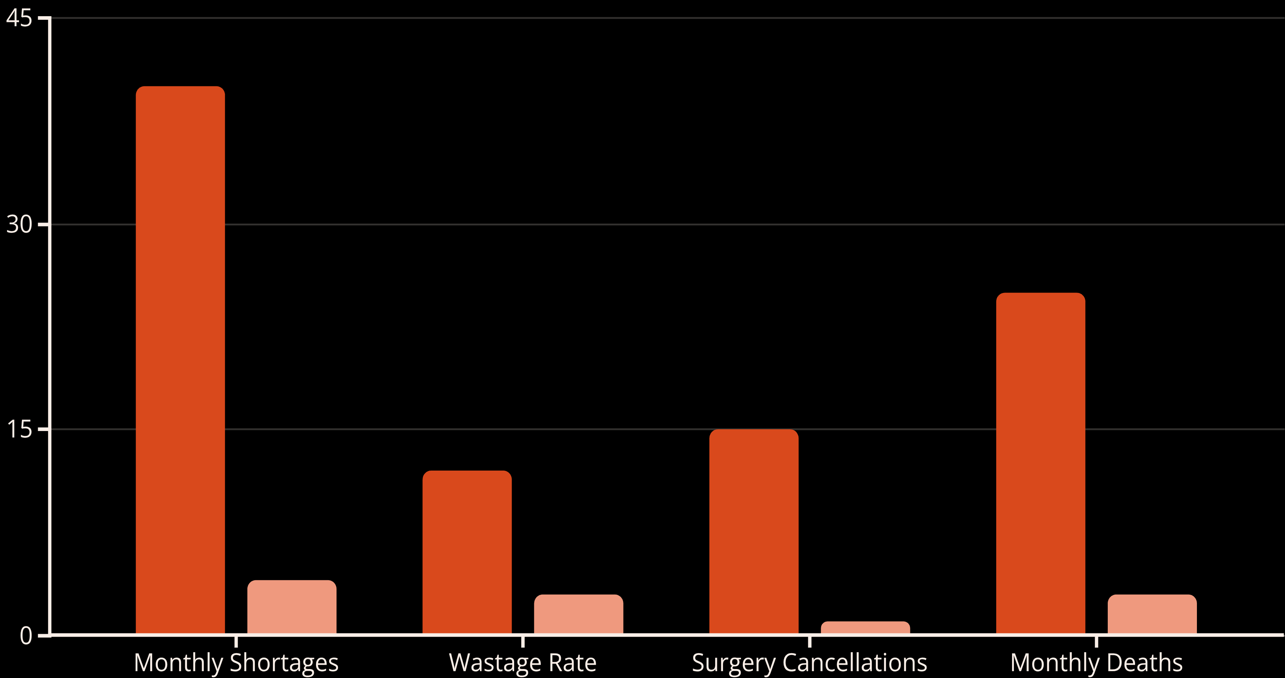
Proven Impact: Pilot City Results
Six-month pilot in a city of 5 million people—the numbers are undeniable.
Before AI
After AI
264 lives saved per year in a single pilot city. Scale to 100 cities: 26,400 lives annually. Scale globally: 3.6 million lives.

Slide 9

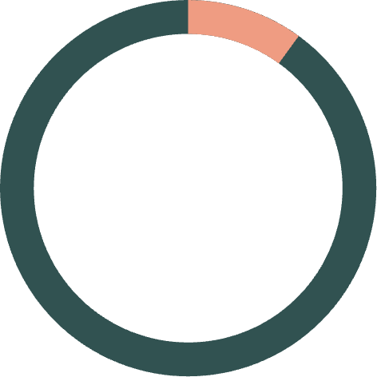
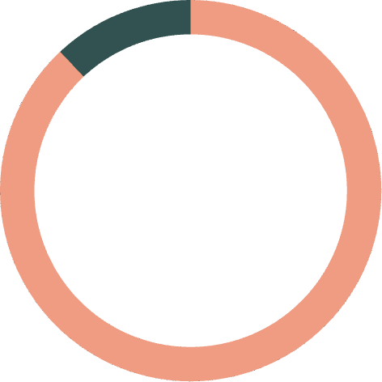
Business Model: Self-Sustaining Impact
Revenue Streams
Hospital subscriptions: $500/month per facility
Government contracts: National blood program partnerships
Insurance partnerships: Share savings from reduced emergency costs
International funding: WHO, Red Cross, global health organizations
Economics at Scale
Transaction cost: $0.05 per coordination event. At 1M transactions yearly: $50K operating cost. Revenue potential: $5-10M annually.
10:1
ROI for Hospitals
Every dollar spent saves ten in blood costs and emergency care
88%
Mortality Reduction
Deaths from blood unavailability nearly eliminated

Slide 10



Nobody "Uses" BloodBank AI—It Just Works
This is the brilliance: zero behavior change required. Hospitals use their existing systems. Blood banks use their existing dashboards. Donors receive normal text messages. Patients receive blood.
Nobody downloads an app. Nobody gets trained. Nobody changes their workflow. The AI simply orchestrates everything behind the scenes—making the entire system work seamlessly.
The Result
The Impact
Fewer people dying. It's that simple.
Lives saved without anyone knowing there's AI involved.
The Future
A blood crisis that finally has a solution.

